Slide 1


Quality management systems (ISO 9001:2015)
THE IMPACT OF ISO 9001:2015 ON ISO 22000 AND FOOD SAFETY MANAGEMENT SYSTEMS
Mr. Lampros Sakkas
Agricultural University of Athens
lasakkas@hotmail.com

Slide 2
Quality management systems (ISO 9001:2015)
THE IMPACT OF ISO 9001:2015 ON ISO 22000 AND FOOD SAFETY MANAGEMENT SYSTEMS
Mr. Lampros Sakkas
Agricultural University of Athens
lasakkas@hotmail.com

Slide 3
Outline
1) The Impact of ISO 9001:2015 on ISO 22000 and Food Safety Management Systems
  Food Safety Management Systems/Definition of ISO 22000
  Impact of ISO 9001:2015 on ISO 22000
2) Basic steps towards implementing the system
  ISO 9001:2015 implementation steps
  Transition from ISO 9001:2008 to ISO 9001:2015

Slide 4
Learning outcomes
The trainee/student will:
- understand purpose and benefits of a Food Safety Management System
- understand purpose, benefits and structure of ISO 22000:2005
- understand purpose, benefits and structure of revised ISO 22000 as an impact of ISO 9001:2015

Slide 5
Food Safety Management Systems
What is food safety? → assurance of food hygiene & harmlessness to consumers
What is a Food Safety Management System? → systematic approach for ensuring food safety

Slide 6
Food Safety Management Systems
HACCP → originated in the 1960s (NASA, Pillsbury, US Army Laboratories)
→ 1st manual was developed in 1973 (Pillsbury)
→ 1st standard was published in 1989 (US NACMF)
→ + 5 preliminary steps
+ PRPs → FSMS concept was born

Slide 7
Food Safety Management Systems
ISO 22000:2005
BRC Global Standard for Food Safety (BRC)
IFS Food (Retailer association of Germany -HDE- and France –FCD- and the contribution of the Italian associations -ANCC & ANCD)
FSSC 22000 (Dutch Organization Foundation for Food Safety Certification)
SQF Code (Food Marketing Institute in the USA)
Dutch HACCP Code (Dutch National Board of Experts-HACCP)

Slide 8
DEFINITION OF ISO 22000
ISO 22000 Food Safety Management System addresses what an organization needs to do to demonstrate its ability to control food safety hazards in order to ensure that food is safe at the time of human consumption and it can be used by any organization regardless of its size or position in the food chain (ISO, 2005)
Key elements: 1) interactive communication
2) system management
3) prerequisite programmes
4) HACCP principles

Slide 9
DEFINITION OF ISO 22000
ISO 22000:2005 combines: HACCP + GMP + ISO 9001
Compatible with ISO 9001
What is Food Quality?
Food Quality Assurance incorporates Food safety
ISO 22000 → requires conformity with FS-related statutory & regulatory requirements
→ offers a more focused, coherent and integrated FSMS than is required by law

Slide 10
THE ISO 22000 FAMILY OF STANDARDS
ISO 22000:2005 → Food safety management systems - Requirements for any organization in the food chain
ISO 22002-1:2009 → Prerequisite programmes on food safety - Part 1:Food manufacturing
ISO/TS 22003:2013 → Food safety management systems - Requirements for bodies providing audit and certification of food safety management systems
ISO/TS 22004:2014 → Food safety management systems - Guidance on the application of ISO 22000:2005
ISO 22005:2007 → Traceability in the feed and food chain - General principles and guidance for system design and development

Slide 11
ISO 22000:2005
Benefits of implementing ISO 22000:2005
Provide products safe for the consumer
Ensure & demonstrate conformity to food safety policy
Demonstrate compliance with legislation
Communicate effectively food safety issues to the interested parties
Improve hygiene & quality of the products
Improve efficiency & process control
Respond to customer demands – gain & maintain customer’s trust
Enhance firm’s reputation – take advantage of a promotional/marketing tool
Facilitate access to foreign markets

Slide 12
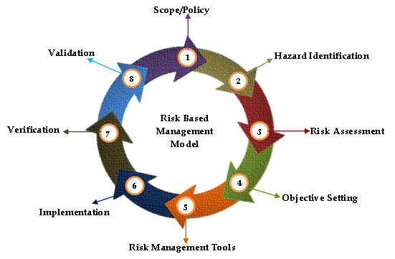
ISO 22000:2005
Risk Based Management Model, from: Lokunarangodage et al (2016)

Slide 13
ISO 22000:2005
ISO 22000:2005 combines: GMP + HACCP + ISO 9001
Effective Prerequisite Programmes → ensure a clean sanitary environment
Hazard Analysis and Critical Control Plan → identify, prevent & eliminate FS hazards
Management elements → manage food safety

Slide 14
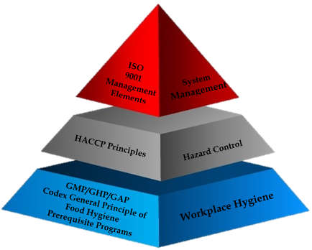
ISO 22000:2005
Three Layer Model of ISO 22000:2005, from: Lokunarangodage et al (2016)

Slide 15
ISO 22000:2005
Prerequisite Programmes (ISO 22002-1:2009 )
Construction and layout of building
Layout of premises and workspace
Utilities - air, water, energy
Waste disposal
Equipment suitability, cleaning and maintenance
Management of purchased material
Measures for prevention of cross contamination
Cleaning and sanitizing
Pest control
Personnel hygiene and employee facilities
Rework
Product recall procedures
Warehousing
Product information
Food defense, biovigilance and bioterrorism

Slide 16
ISO 22000:2005
ISO 22000:2005 requirements
Food Safety Policy
Quality objectives
Planning, designing & documenting a management system
Records of system performance
Food Safety Team & Team Leader
Defining communication procedures
Emergency plan
Management review
Adequate resources
Implementing PRPs
Following HACCP principles
Traceability system
Corrective action system & control of nonconforming product
Documented procedure for handling withdrawal of product
Control monitoring & measuring devices
Internal audit program
Continual update & improvement

Slide 17
IMPACT OF ISO 9001:2015 ON ISO 22000
ISO 9001:2015 → significant changes
new concepts and approach
more emphasis on process management/less emphasis on documentation
ISO directive “Consolidated ISO Supplement” requirements for MS Standards:
  high level structure
  identical core text ,common terms & definitions
Aims of ISO 22000 revision: - increase compatibility with other MS standards
- clarify key concepts
- improve readability & usability
- ensure relevance to the whole food chain
DIS 22000 published in March 2017, new version expected to be published in June 2018

Slide 18
IMPACT OF ISO 9001:2015 ON ISO 22000
Impact of ISO 9001:2015 - Major proposed changes to the ISO 22000 Standard
High level structure
Risk-based thinking
The PDCA cycle
Documentation
Terminology
Other changes

Slide 19
IMPACT OF ISO 9001:2015 ON ISO 22000
High Level Structure
ISO 9001:2015 → same overall structure as other ISO management system standards (High Level Structure)
Reviewing 22000 → High Level Structure → facilitates the implementation of multiple ISO standards
High Level Structure → ten clauses
identical core text
common terms & definitions
Impact on the system scope, top management involvement, documentation, application of the risk-based approach, clear focus on the process approach

Slide 20
IMPACT OF ISO 9001:2015 ON ISO 22000
High Level Structure
Scope
Normative references
Terms and definitions
Context of the organization
Leadership
Planning
Support
Operation
Performance evaluation of the food safety management system
Improvement

Slide 21
IMPACT OF ISO 9001:2015 ON ISO 22000
Risk-based thinking
The concept of risk has always been implicit in ISO 9001
2015 revision makes it more explicit, building it into the whole management system
Risk-based thinking → part of the process approach:
ISO 9001:2015 (4.4 Quality management system and its processes)
DIS 22000 (4.4 Food Safety Management System)
DIS 22000/Introduction: concept & scope of risk-based thinking
Risk-based thinking → preventive action part of the company’s routine:
ISO 9001:2015 & DIS 22000 (6.1 Actions to address risks and opportunities)

Slide 22
IMPACT OF ISO 9001:2015 ON ISO 22000
Risk-based thinking
Risk management already considered in ISO 22000:2005 (HACCP)
Risk-based thinking in now addressed in two levels:
  Operational level (HACCP)
  Strategic level of the management system (business risk)
New concept of business risk → will enable food companies to embrace opportunities
Implications: business planning
management objectives
identifying improvement opportunities
allocating resources to reduce or eliminate unacceptable risk to food safety
clarified approach to product withdraws and recalls

Slide 23
IMPACT OF ISO 9001:2015 ON ISO 22000
The PDCA cycle
More emphasis on process approach, as in ISO 9001:2015 (PDCA cycle)
DIS 22000/Introduction: process approach & PDCA cycle
Application of the PDCA cycle more clearly established
Two separate PDCA cycles instead of one
The two PDCA cycles will operate one inside the other:
  one covers the overall food safety management system &
  the other, within it, covers the operational processes → principles of HACCP

Slide 24
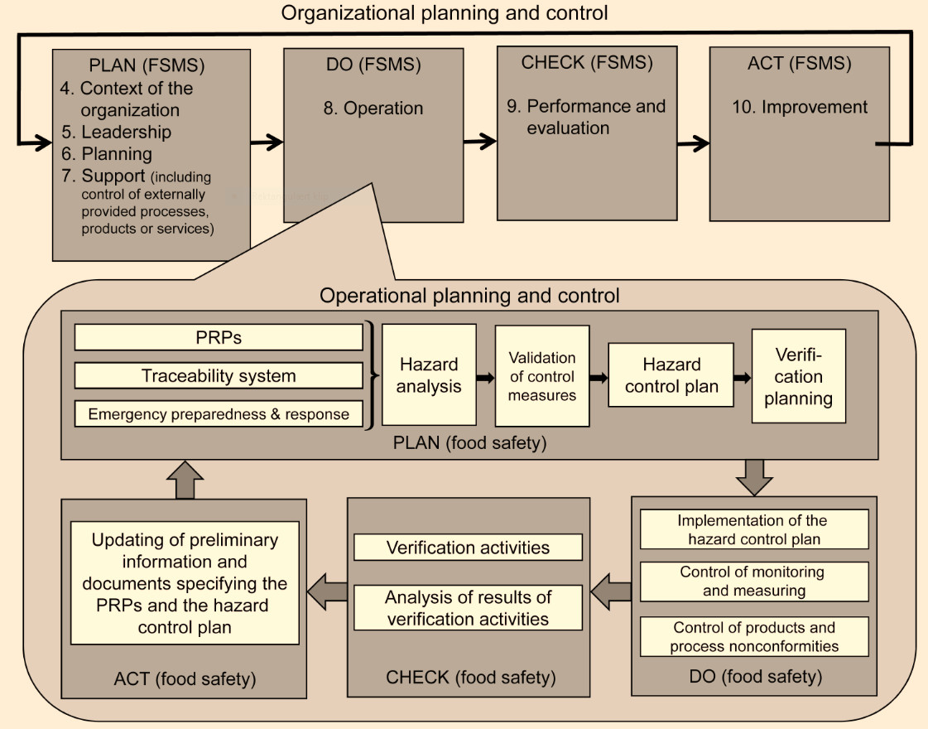
IMPACT OF ISO 9001:2015 ON ISO 22000
Illustration of the two Plan-Do-Check-Act cycles, from: ISO/DIS 22000 (2017)

Slide 25
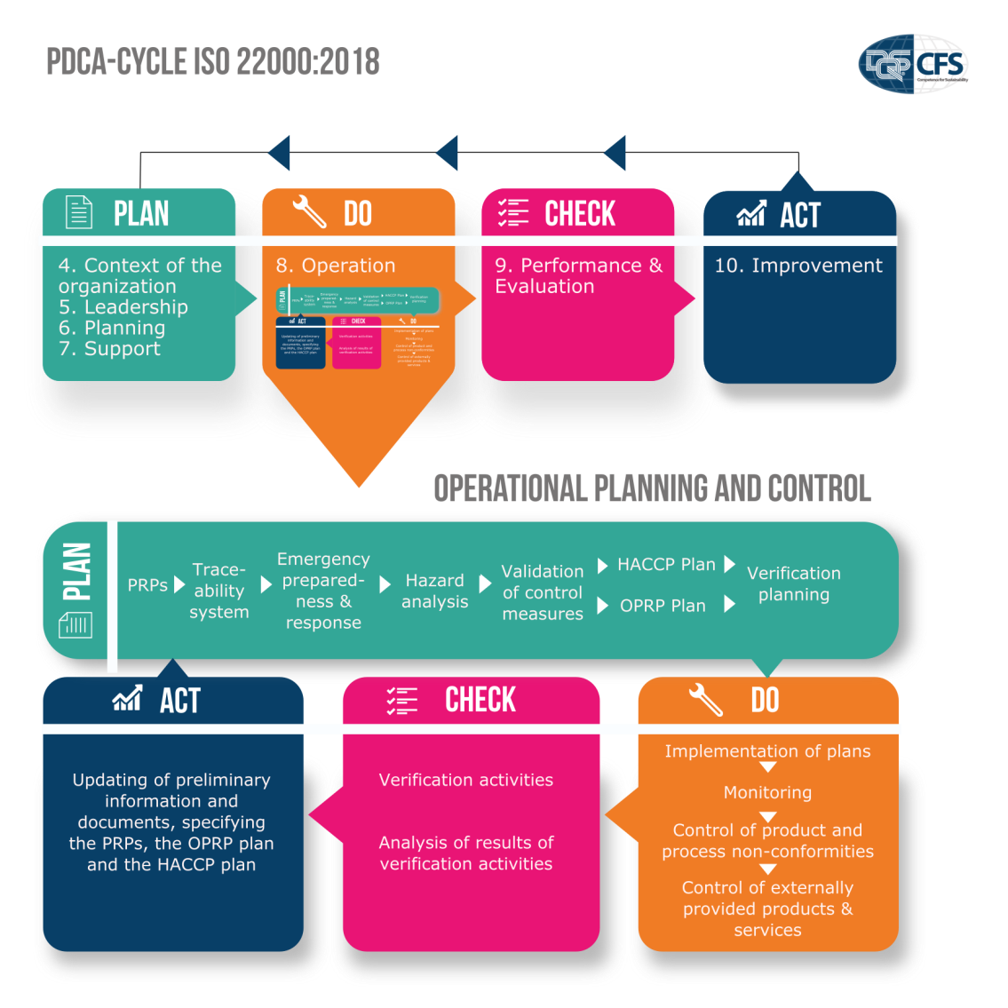
IMPACT OF ISO 9001:2015 ON ISO 22000
PDCA cycle in ISO 22000:2018, from: Willaert (2017)

Slide 26
IMPACT OF ISO 9001:2015 ON ISO 22000
Documentation
ISO 9001:2015 requires: information to be maintained or retained
does not require: documented procedures & files
DIS 22000: Some mandatory documentation is still specified and it is expected that some documented processes could be required (due to the nature of FSMS)
DIS 22000: convergence of ‘procedures’ and ‘records’ into ‘documented information’ The organization is free to define the type & extent of documented information to be used
Established control for documents is retained
ISO 9001:2015 does not require any longer a Quality Management Manual
ISO 22000:2005 did not include a requirement for a food safety manual

Slide 27
IMPACT OF ISO 9001:2015 ON ISO 22000
Terminology
ISO 9001:2015 → places more emphasis on leadership and management commitment
→ requires greater involvement by top managers and business leaders in controlling the QMS
Impact on DIS 22000: convergence of ‘management responsibility’ into ‘leadership’
  Role of top management is emphasized
  Overall responsibility of top management is retained
Clear description of the differences between key terms:
  Critical Control Points (CCPs)
  Operational Prerequisite Programmes (OPRPs)
  Prerequisite Programmes (PRPs)

Slide 28
IMPACT OF ISO 9001:2015 ON ISO 22000
Context and Scope
New version of ISO 22000 will require organizations to consider upstream and downstream
issues affecting customers and consumers as well as providers of products and services
New requirements concerning the context of the organization
Context will have to be formally documented
Impact on the scope of the FSMS

Slide 29
IMPACT OF ISO 9001:2015 ON ISO 22000
Planning
Planning to achieve the FSMS objectives
Planning of changes
Support
Communication control → clarified & strengthened
Tighter control of providers & subcontractors
Competence & awareness

Slide 30
IMPACT OF ISO 9001:2015 ON ISO 22000
Operation
DIS 22000 requirements clarify the role of PRPs, OPRPs and CCPs in the FSMS
ISO/TS 22002-X must be considered in the determination of PRPs
Records for the selection, establishment, applicable monitoring & verification of PRPs
Traceability & emergency response are tightened up:
  Traceability system → tested & verified for its effectiveness
  “Preventive action” → deal with potential emergency situations & incidents
Process environment for hazard analysis → seasonal changes or shift patterns are considered

Slide 31
IMPACT OF ISO 9001:2015 ON ISO 22000
Operation
Control measures → categorized as OPRPs or CCPs
  OPRPs → measurable and/or observable action criteria
  CCPs → only measurable critical limits that enable timely correction
Hazard Control Plan includes → 1. HACCP plan
→ 2. OPRP plan
FSMS deals with OPRPs & CCPs in similar ways
Verification activities → performed by independent personnel

Slide 32
IMPACT OF ISO 9001:2015 ON ISO 22000
Evaluation and Improvement
Requirements for performance evaluation retained
Greater emphasis on the use of a more integrated, systematic approach
Evaluation outcomes → prevention of failure → improve FSMS effectiveness

Slide 33
Correspondence between QMS ISO 9001:2015 & FSMS ISO/DIS 22000:2017 (1)

Slide 34
Correspondence between QMS ISO 9001:2015 & FSMS ISO/DIS 22000:2017 (2)

Slide 35
Correspondence between QMS ISO 9001:2015 & FSMS ISO/DIS 22000:2017 (3)

Slide 36
IMPACT OF ISO 9001:2015 ON ISO 22000
ISO 22000 major changes concerning clauses
5. Leadership
6.2. Objectives of the food safety management system and planning to achieve them
7.1.6 Control of externally provided processes, products or services
8.2 PRPs
8.3 Traceability
8.4 Emergency preparedness and response
8.5.1 Preliminary steps to enable hazard analysis
8.5.2 Hazard analysis
8.5.4 Hazard control plan (HACCP/OPRP plan)
8.8.1 Verification

Slide 37
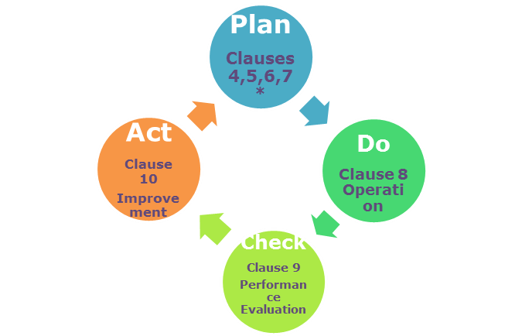
9001:2015 IMPLEMENTATION STEPS
How I can get started
PDCA Cycle in correlation to ISO 9001 clauses, from: Tsakalou and Papakonstantinou (2017)
* Clause 4 Context of the organization, Clause 5 Leadership, Clause 6 Operation, Clause 7 Support

Slide 38
9001:2015 IMPLEMENTATION STEPS
Steps to be undertaken
Step 1 – Define the objectives of the organization
Step 2 – Make sure senior management is on board
Step 3 – Identify your organization’s key processes for meeting your objectives as well as your customers’ needs
Step 4 – Buy the Standard and appoint a Quality Manager and the Quality team

Slide 39
9001:2015 IMPLEMENTATION STEPS
Steps towards certification
Evaluate whether certification makes sense for your organization
Main considerations:
  Current level of conformance with ISO 9001 requirements
  Amount of resources that the company will dedicate to this project for development & implementation
  Amount of support that will be required from a consultant & the associated costs
  Costs for ISO 9001 registration, surveillance & recertification audits

Slide 40
9001:2015 IMPLEMENTATION STEPS
Steps towards certification
Find a certification body. In doing so, you should:
  build up a team and train the employees for the overall scope as well as the implementation processes
  identify and evaluate as many certification bodies as possible
  check if the certification body uses the relevant CASCO standard. ISO/IEC TS 17021-3:2013 sets out the requirements for bodies providing audit & certification to QMS’s
  check that the certification body is accredited (accreditation is not compulsory)

Slide 41
TRANSITION FROM ISO 9001:2008 TO ISO 9001:2015
Familiarize yourself with the new document
Baseline measurement
Plan of approach
Implementation
Training
Auditing and process analysis
Certification
Communication with interested parties

Slide 42
References
1. Escanciano C., Santos-Vijande M. L., 2014. Reasons and constraints to implementing an ISO 22000 food safety management system: Evidence from Spain. Food Control 40, 50-57.
2. Fernandez-Segovia I., Perez-Llazer A., Peidro B., Fuentes A., 2014. Implementation of a food safety management system according to ISO
22000 in the food supplement industry: A case study. Food Control 43, 28-34.
3. ISO 22000:2015, Food safety management systems – Requirements for organizations throughout the food chain
4. ISO/DIS 22000:2017, Food safety management systems – Requirements for any organization in the food chain
5. Lokunarangodage C.V.K., Wickramasinghe I., Ranaweera K.K.D.S., 2016. Review of ISO 22000:2005, Structural Synchronization and Ability to Deliver
Food Safety with Suggestions for Improvements. Journal of Tea Science Research 6(2), 1-12.

Slide 43
References
6. Silva M. M., Fonseca L. M., Sousa S. D., 2016. The Impact of ISO 9001:2015 on ISO 22000 and Food Safety Management Systems (FSMS). Quality, Access to Success 17(152), 81-85.
7. Tsakalou L., Papakonstantinou S., 2017. How a company can get started and certified with the Standard, in: Quality Management Systems (ISO 9001:2015), pp. 51-57. Editor: Agricultural University of Athens.
8. Willaert T., 2017. The revision of ISO 22000: An Overview of the coming changes. dqs-cfs.com/2017/02/revision-iso-22000-overview-coming-changes/
9. www.fao.org/fao-who-codexalimentarius/sh-proxy/es/?lnk=1&url=https%253A%252F%252Fworkspace.fao.org%252Fsites%252Fcodex%252FMeetings%252FCX-712-47%252FCRD%252FFH47_CRD12x.pdf

Slide 44
Self-evaluation questions
What is a Food Safety Management System?
(correct answer: It is a systematic approach for ensuring food safety)
(2) The expected impact of ISO 9001:2015 on ISO 22000 includes:
A. Structure of the Standard
B. Terminology
C. Documentation
D. All above
(correct answer: D)
(3) In line with ISO 9001:2015, the new version of ISO 22000 is expected to:
A. place less emphasis on process approach
B. place more emphasis on management commitment
C. include a requirement for a food safety manual
(correct answer: B)

Slide 45

Author(s) information
Veterinarian
MSc in Food Science and Nutrition
PhD student in Food Science and Technology-Dairy Research
Quality Assurance and Food Safety consultant
Lampros Sakkas

